Slide 1
E-commerce website
By Waleed Alharbi

Slide 2
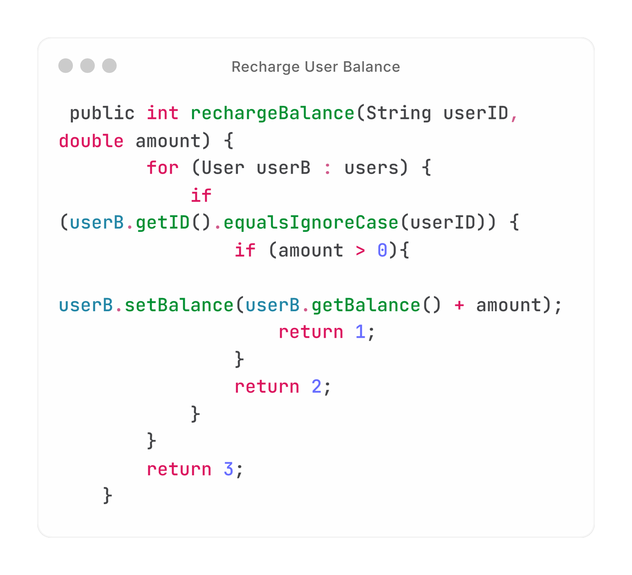
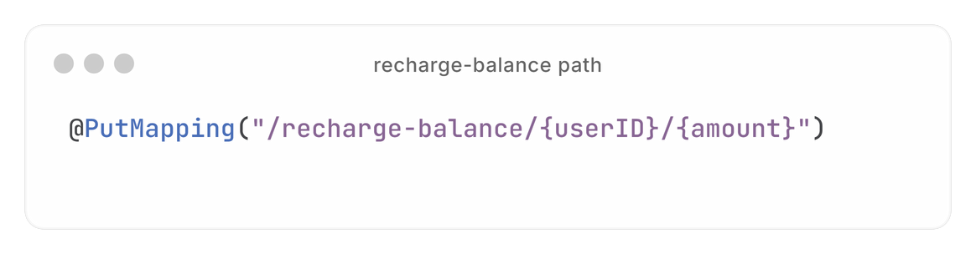
Recharge Balance
Logic of endpoint :
Path of endpoint :

Slide 3
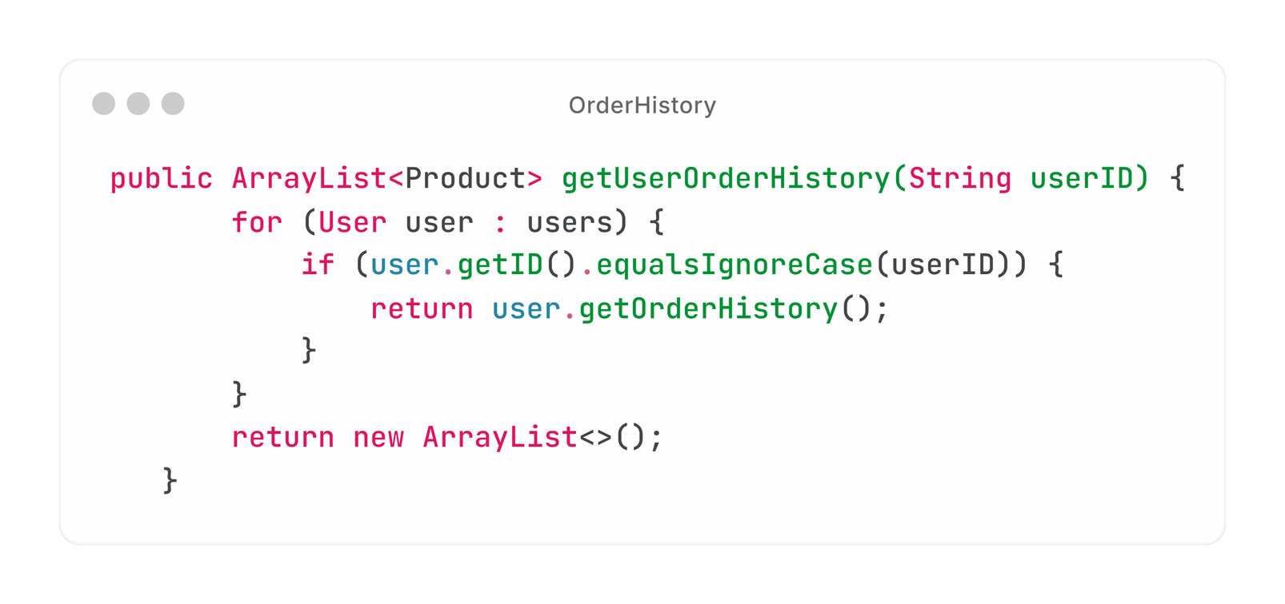
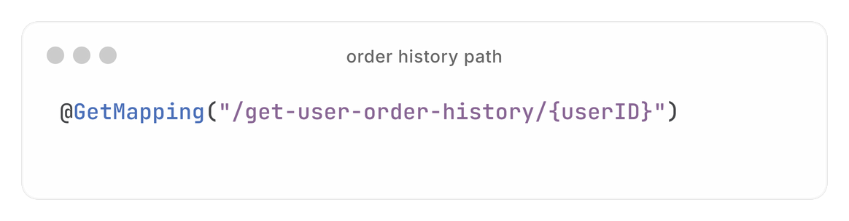
Order History
Logic of endpoint :
Path of endpoint :

Slide 4
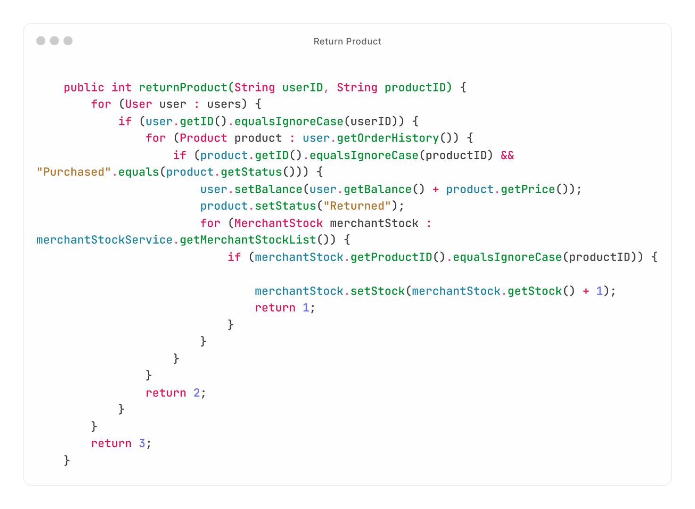
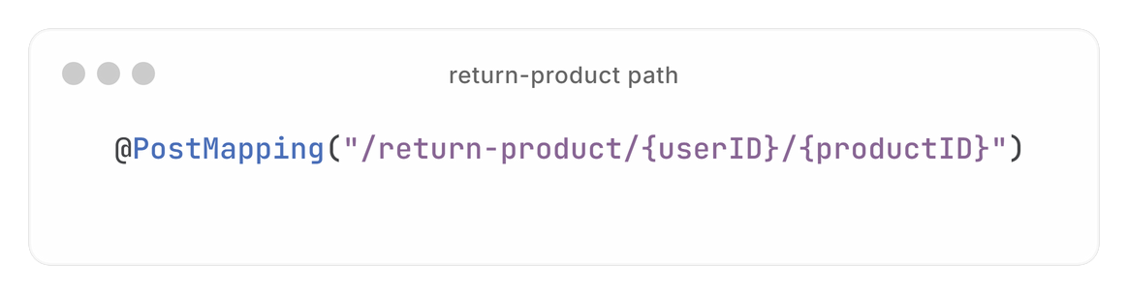
Return Product
Logic of endpoint :
Path of endpoint :

Slide 5
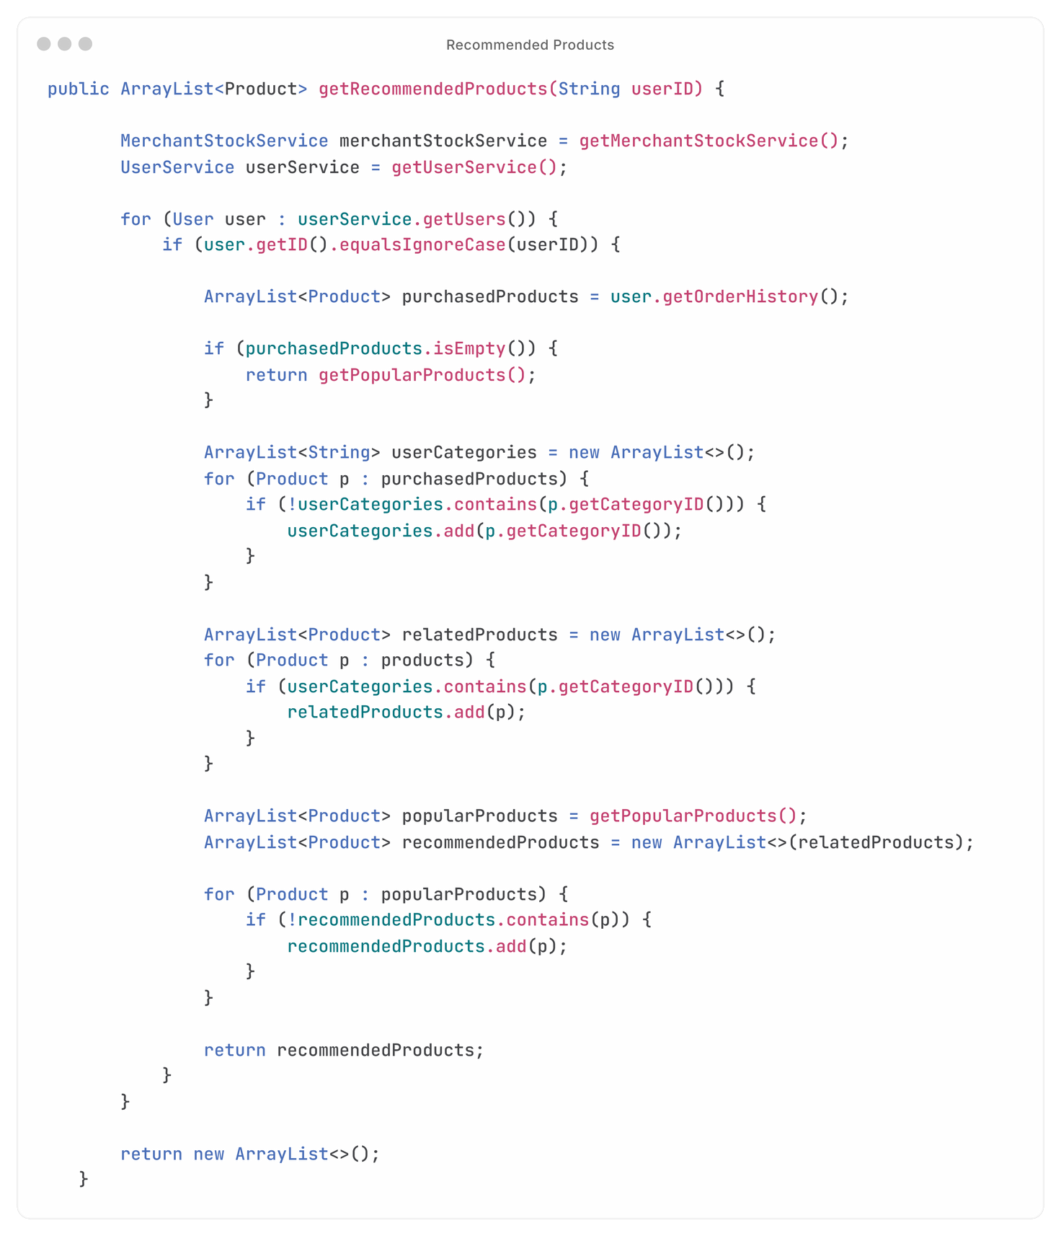
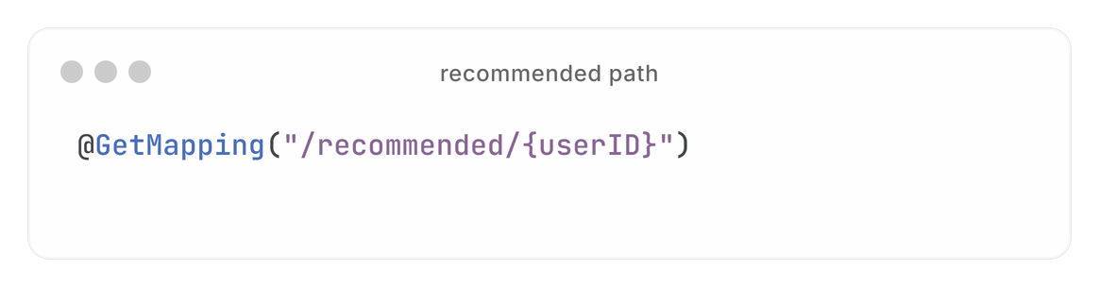
Recommended Products
Path of endpoint :

Slide 6
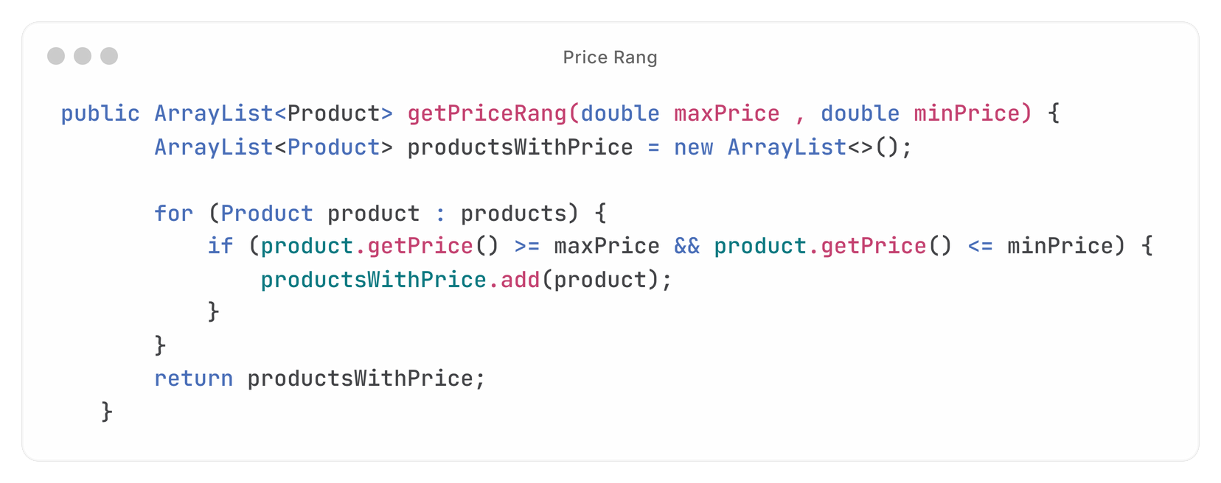
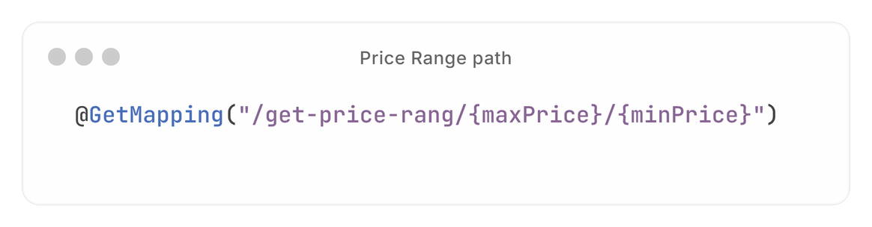
Price Range
Logic of endpoint :
Path of endpoint :

Slide 7
Thank You

